Slide 1
Texas High-School Graduation Analysis
Rodrigo Ivan Rodriguez

Slide 2
Introduction
I am looking to answer the question of what school locations are best in terms of graduation rates, rural schools or urban schools.
Additionally, I want to see what other factors may also impact graduation rates, since I know that location alone may not be enough to explain differences in graduation rates.

Slide 3
Primary Question & Hypothesis
There are a few questions I am hoping to answer with the available data. However, my primary question asks:
Do Urban Schools have higher graduation rates than rural schools?
My initial hypothesis is that Urban Schools do have higher graduation rates than Rural Schools.

Slide 4
Data, Variables, and EDA

Slide 5
Data & Variables
Data
Variables
The dataset I chose was provided by the Texas Education Agency (a state government agency).
The dataset provides 4-year longitudinal graduation data for the classes of 2018-2020 and breaks out data by various student characteristics.
The raw dataset has 347 variables; however, I narrowed the variables for the purposes of this project to the following.
Campus, District, County, Region, Class Size, Graduation Rate, Hispanic Class Size, Hispanic Graduation Rate, Economically-disadvantaged and Non-disadvantaged Class Size (and Graduation Rate), Region Type, and lastly Preparatory Indicator.
Source:
https://tea.texas.gov/reports-and-data/school-performance/accountability-research/completion-graduationand-dropout/four-year-graduation-and-dropout-data-class-of-2020

Slide 6
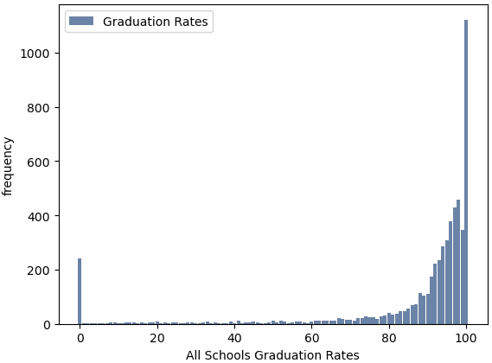
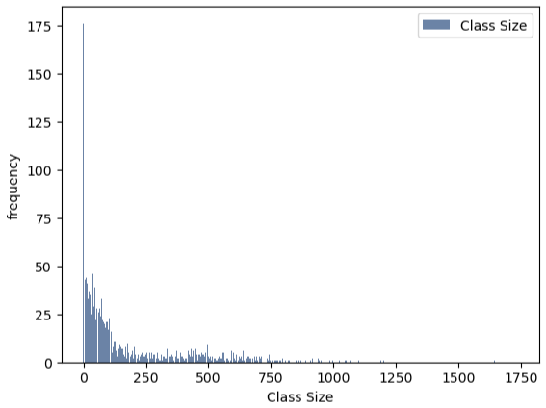
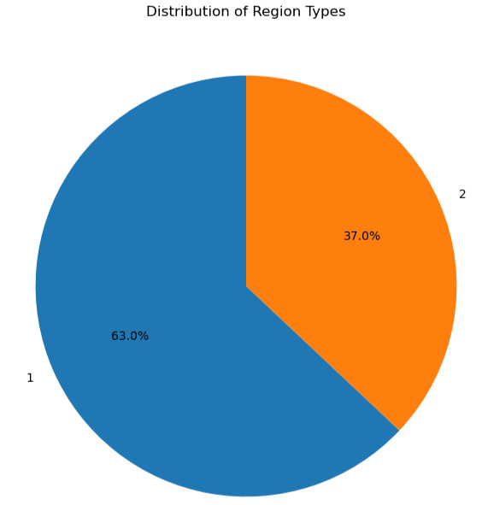
EDA
Graduation Rate Hist.
Class Size Hist.
Region Type Dist.
1 = Rural
2= Urban

Slide 7
EDA Summary
The EDA analysis provided context on the distribution of the variables used for this project and their skewness.
Additionally, the analysis identified several outliers in some key variables For example the variable of Hispanic Graduation Rates has a high 0 count. This occurs because some rural schools have a 0 count of Hispanic students and thus a 0-graduation rate. Additionally, the variable for total class size 'CAMP_ALLD' should not be 0; zero values for this variable need to be filtered out.
To handle this, I cleaned the data by creating a new data frame that filters out zero values in the class size variable.
Then create separate data frames for specifically analyzing subsets like Hispanic and Economic status. These separate data frames will filter out 0 class sizes for these subsets and thus normalized the class size and graduation rates for these subsets.

Slide 8
Analysis

Slide 9
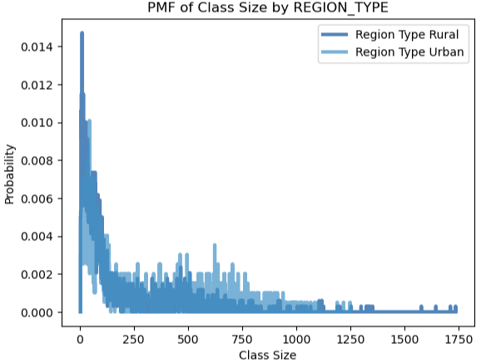
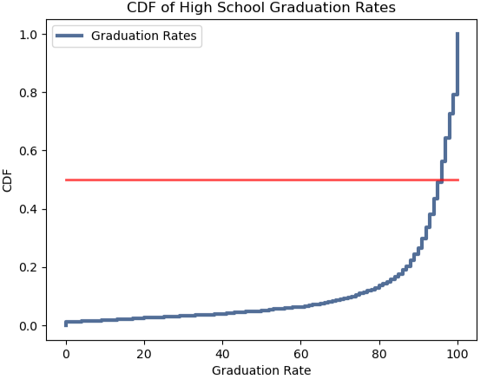
PMF & CDF
Probability Mass Function
Cumulative Distribution Function

Slide 10
PMF & CDF
The PMF plots the shows probability of class size by region type. The plot shows that class sizes are right-skewed, and that there are more rural schools with smaller class sizes and more urban schools with larger class sizes.
Based on the CDF I can see that there is not much variability between graduation rates for most schools. While variation does exist and some schools do in fact have low graduation rates, most schools have graduation rates concentrated above the 90% mark with a median of 96%

Slide 11
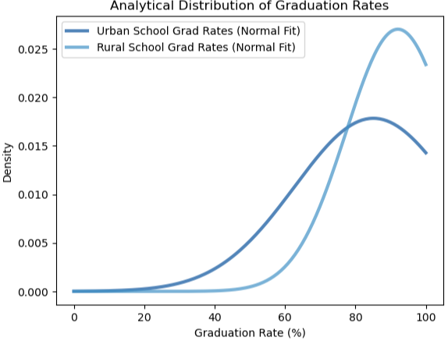
Analytical Distribution: PDF
How it applies:
Probability Density Function
My main problem aims to find out if urban schools have higher graduation rates than rural schools? This was my hypothesis before starting the analysis.
The PDF of Urban School Graduation Rates, and Rural School Graduation rates show that Rural schools actually have higher graduation rates that Urban schools. Based on visually interpreting this plot, Urban Schools have an approximate mean graduation rate of 80 and Rural Schools have an approximate mean graduation rate of 90.
Also, the spread of Urban schools is more dispersed so while Rural schools generally perform better, there is more variability in the performance of Urban schools.

Slide 12
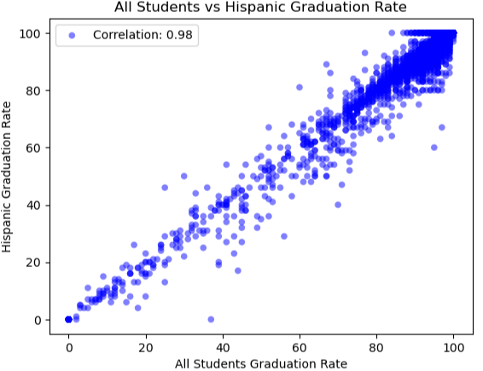
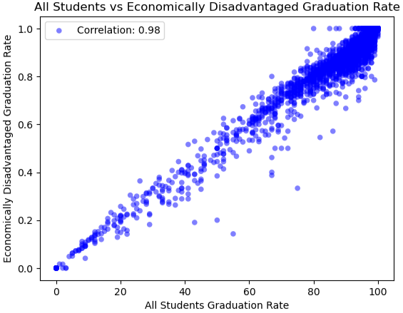
Correlation & Causation
Plot of Hispanic Grad. Rates
Plot of Econ-Dis Grad. Rates

Slide 13
Correlation & Causation
The relationships observed in both plots indicates that the graduating outcome of Hispanic students and of Economically Disadvantaged students are highly consistent with the broader school outcomes.
This confirms that neither ethnicity nor economic status play a role in determining a student's academic performance, rather the broader school performance is a more reliable predictor of student performance.
Lastly, correlation does not equal causation. While graduation rates of both subsets move in tandem with overall graduation rates, we cannot say that one rate causes the other.

Slide 14
Hypothesis Testing
How it applies:
Difference of Means Test Results
My primary hypothesis is that Urban Schools have higher graduation rates than Rural schools. To test this, I ran a difference of means hypothesis test (t-test).
In summary, the statistical analysis suggests that there is a statistically significant difference in graduation rates between rural and urban regions, with rural regions having a higher mean graduation rate.
Given the very low p-value, this indicates that the observed difference in graduation rates between rural and urban regions is statistically significant and not likely due to random chance.
This could warrant further investigation into the factors contributing to higher graduation rates in rural areas compared to urban areas.
92.05% Mean Grad. Rate of Rural Schools
85.09% Mean Grad. Rate of Urban Schools
2.4036 t-statistic
2.40e-34 p-value

Slide 15
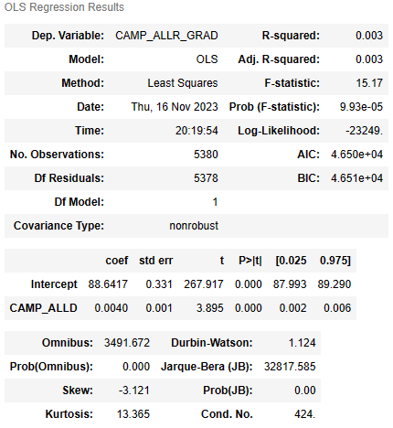
Regression Analysis
Ordinary Least Squares Reg.
How it applies:
My subsequent theory was that class size might be a good predictor of graduation rates.
To test this, I ran a regression analysis to see if graduation rates have a relationship with class size.
The results of the linear regression shows that while there is a statistically significant relationship between the two variable, the R-squared value is only .003 and thus the relationship is too weak to be practical.
This can be further used with the t-test done during hypothesis testing to reiterate that class size does not have a substantial impact on graduation rates. Rather, graduation rates may be influenced more by other factors not included in this dataset.

Slide 16
Conclusion
This project is a good starting point but there exists an opportunity to expand on the analysis conducted for this project.
There is an opportunity to expand on this work by introducing additional variables into the data, further exploring the difference between Rural and Urban schools, and by experimenting with non-linear models to improve the chances of predicting graduation rates.

Slide 17
Thank you
Rodrigo Ivan Rodriguez

